Slide 1

Dawood University of Engineering & Technology
MAHMUD Ghaznavi (997-1030)
Lecture # 3

Slide 2
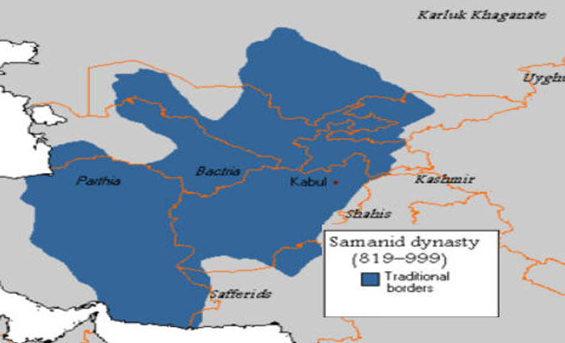
INTRODUCTION:
Samanida Dynasty time period was (819-999) A.D
Its Governor name was Alaptagin, in 962 A.D he captured Ghazni city in Afghanistan, & declear independent himself.
Subgutagin was his slave who create important role in the capturing the Ghazni, so that he appointed him as Commander-in Chief of his army, he was also Son-in law of Alpatagin.
Alaptagin died in 976 A.D and after two years his son Abu Ishaq also died.
After his death nobles appointed Subgutagin as new ruler of Ghazni Dynasty (977-997).
When he became king of Ghazni Dynasty, his Abulghasim Mahmud was six years old. History know him as Mahmud Ghaznavi.

Slide 3
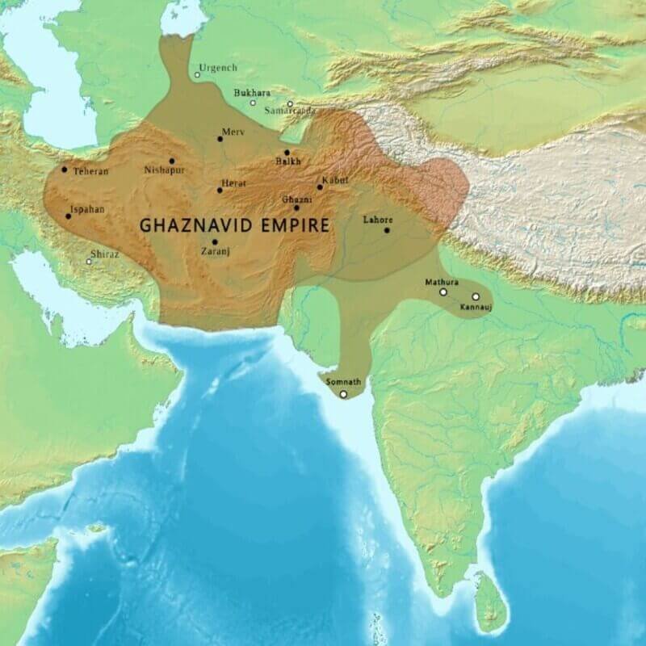
INTRODUCATION:
In the 9th century Arab empire started disintegrating and declined. • The kingdom emerged prominent, the city of Ghazni which is in present day Afghanistan.
•The rulers of the kingdom invaded and plundered the Indian subcontinent in the 10th and 11th centuries.
•By the 10th and 11th century the north India had disintegrated into many small kingdoms which gave huge advantage to these rulers.
•These attacks were done to finance their ambition of expanding their empire.

Slide 4
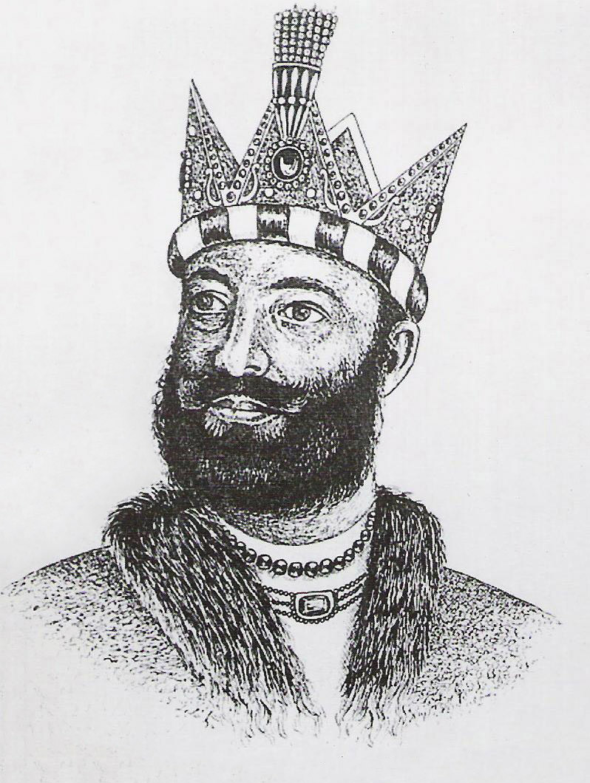
Mahmud of Ghazni ( AD 997-1030)
After the decline of Abbasid Dynasty Subuktigin a Turkish noble acquired the adjoining parts of Ghazni.
His son Mahmud wanted to achieve the glory of the greatest conqueror of the world.
He had heard about the wealth of the Indo- Gangetic plains.
He attacked and plundered north India 17 times from AD 1001 to 1027.
He believed in the jihad (holy war which will lead to heaven) and plundering the region.
He looted the rich temples and trade centers e.g Siestan and Multan.
Mahmud Ghaznavi moved to Sub-continent in Winter, & in Sumer he moved Central Asia.
His attacks aim was just collect wealth to made rich Ghaznavi Dynasty.

Slide 5
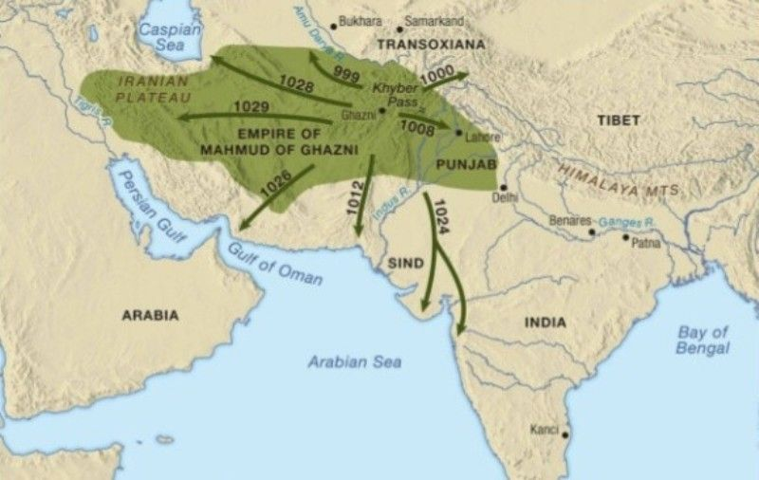
ATTACKS OF MAHMUD:
999: Khorasan, Balkh, Herat, Merv from the Samanids. A concurrent invasion from the north by the Qarakhanids under elik khan (Nasr khan) ends Samanid rule.
1000: seistan1001: Gandhara: sultan Mahmud defeats Jayapala at Peshawar and Jayapala abdicates and commits suicide.
1002: Seistan: Imprisoned Khuluf
1004: Bhatia (Bhera) annexed after it fails to pay its yearly tribute.
1005: Multan Fateh Daud the Shia Ismaili ruler of Multan
1005: Defends Balkh and Khorasan against Nasr-I of the Qarakhanids and recaptures Nishapur from Isma'il Muntasir of the Samanids.

Slide 6
1005: Sewakpal Rebels and is defeated.
1008: Mahmud defeats the Rajput confederacy (Ujjain, Gwalior, Kalinjar, Kannauj, Delhi, and Ajmer) in battle between und and Peshawar, and captures the Shahi treasury at Kangra in Himachal Pradesh.
1010: Ghur; against Mohammad ibn Sur.
1010: Multan revolts; Abul fatah dawood imprisoned for life at Ghazni.
1011: thanesar1012: Joor-jistan: captures Sar , Abu-Nasr.
1012: Demands and receives remainder of the province of Khorasan from the Abassid caliph. then demands Samarkand as well but is rebuffed.
1013: Bulnat: defeats Trilochanpala.
1014 :Kafirstan attacked.

Slide 7

1015: Ghaznis expedition to Kashmir fails. Fails to take the Loharafort at Lokote in the hills leading up to the valley from the west.
1015: Khwarezm: marries his sister to Abul Abbas Mamun of Khwarezm who dies in the same year in a rebellion. Moves to quell the rebellion and installs a new ruler and annexes a portion.
1017: Kannauj, Meerut, and Muhavun on the Yamuna, Mathura and various other regions along the route. While moving through Kashmir he levies troops from vassal prince for his onward march, Kannauj and Meerut submitted without battle.
1021: Raises Ayaz to kingship, awarding him the throne of Lahore.
1021: Kalinjar attacks Kannauj: he marches to their aid and finds the last Shahi king Trilochanpaala encamped as well.
Takes Lahore on his return. Trilochanpala flees to Ajmer. First Muslim governors appointed east of the Indus river.

Slide 8
1023: Lahore, Kalinjar, Gwalior: no battles, exacts tribute. Trilochanpala, the grandson of Jayapal was assassinated by his own troops. Official annexation of Punjab by Ghazni. Also fails to take the Lohara fort on the western border of Kashmir for the second time.
1024/1025: Ajmer, Nehrwala, Kathiawar: this raid was his last major campaign. The concentration of wealth at Somnath was renowned, and consequently it became an attractive target for Mahmud, as it had previously deterred most invaders. The temple and citadel were sacked, and most of its defenders massacred.
1024/1025: Somnath: Mahmud sacked the temple and is reported to have personally hammered the temple's gilded lingam to pieces and the stone fragments were carted back to Ghazni, where they were incorporated into the steps of the city's new Jama masjid (Friday mosque)
1025: Marched against the Jats of the Jood mountains who harried his army on its return from the sack of Somnath. In he placed a new king on the throne in Gujarat as a tributary and took the old one to Ghazni as a prisoner.
His return detoured across the Thar desert to avoid the armies of Ajmer and other allies on his return.

Slide 9
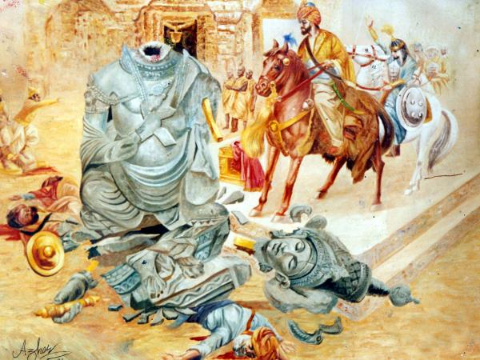
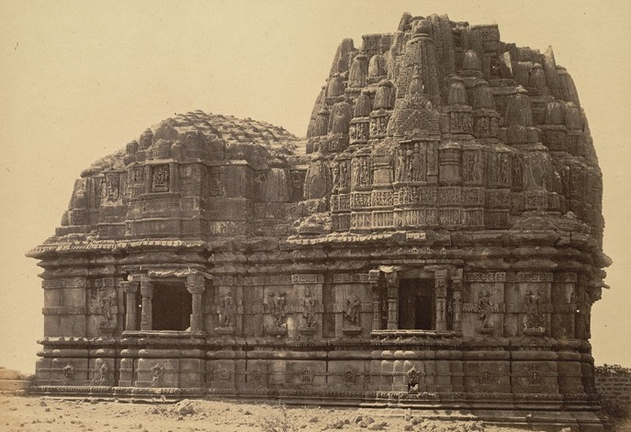
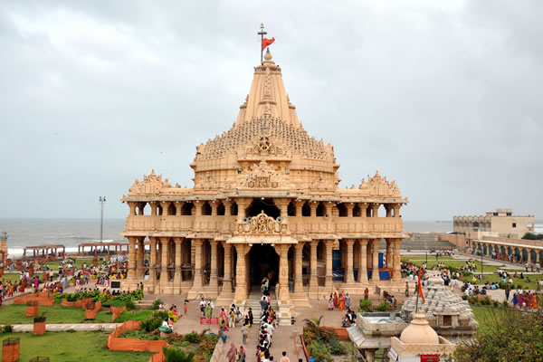
He was famous for his Somnath’s attack, which took place in 1025 A.D, were he collect 6.5 tone gold.

Slide 10
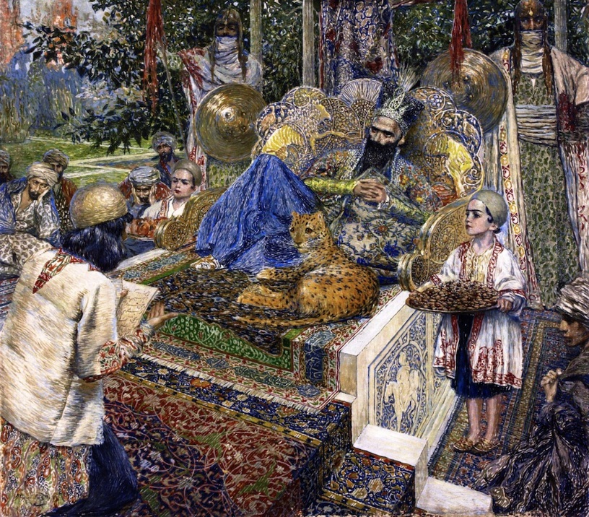
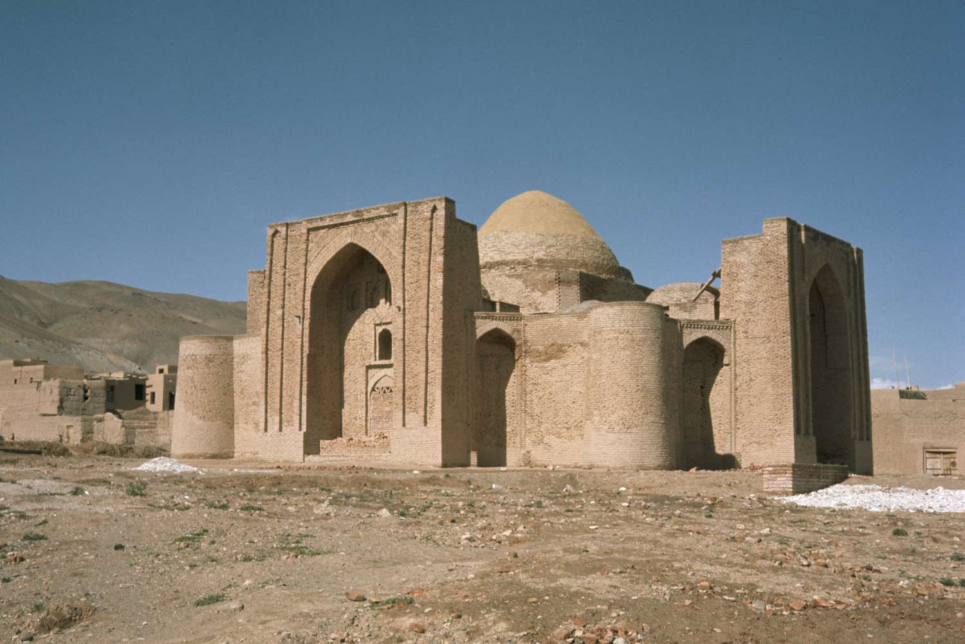
Death of Mahmud Ghazni
Mahmud Ghaznvi died on 30th April 1030 A.D. at the age of 58.
Sultan Mahmud had contracted malaria during his last invasion. The medical complication from malaria had caused lethal Tuberculosis.
The Ghaznavid empire was ruled by his successors for 157 years.
Al-Baruni – A scholar , & Persian poet Firdausi who wrote Shahnama belong to Mahmud’s court.
From 1163-1187, Ghaznavi Dynasty’s capital remain Lahore, during its last three rulers.
Khusru Malik was last ruler of Ghanavi Dynasty.

